Slide 1
China Healthcare Industry and Market
Industry Introduction
Challenges & Opportunities

Slide 2
Industry Introduction
Huge room for healthcare industry improvement
2010 China’s Health Expenditure was 5.1% of the GDP
World’s average was 6.4%
China’s Healthcare Expenditure per person:
12%-13% of increase in future 5 years
Developed Countries’ average was 8.1%
China ranked 149 in the world
Reasons for fast growth of health expenditure
Macro economy’s growth leads to income increase
China’s Health Expenditure:
17.6% of average growth rate in 30 years
Urbanization and aged population growth
Changes of Disease Spectrum:
Death rate increase in: Malignant Tumor,
Cardiovascular and Cerebrovascular diseases,
Mental Disorders,
and Nutrition metabolism and endocrine
system diseases
Government investment increase
Insurance
From WHO statistic yearbook and Tengwei 2013 semiannual summit

Slide 3
Sub Industry | Output （B RMB） | Year-on-year | %
API | 298.5 | 15.80% | 18.23%
Chemicals | 455.2 | 24.30% | 27.79%
Biotech | 166.6 | 18.70% | 10.17%
Devices | 140.1 | 20.80% | 8.55%
Materials | 118.0 | 24.60% | 7.20%
Chinese Med | 369.2 | 21.50% | 22.54%
Decoction Pieces | 90.2 | 26.60% | 5.51%
Healthcare Industry Capability
Manufacturers:
Chemicals: 3454
API: 1318
Chinese Medicine: 2577
Biotech: 202
VDR: 62
Chinese drug decoction pieces:1236
In 2012, China’s GDP growth rate dropped to 7.8%
Healthcare Industry Output increased to 21.3%
GDP
From WHO statistic yearbook and Tengwei 2013 semiannual summit

Slide 4
Healthcare Industry Revenues
In 2012, Revenue growth rate increased to 16.23%, lower than output increase
Sub Industry | Revenue （B RMB） | Year-on-year | %
API | 183.3 | 0.02% | 13.29%
Chemicals | 434.2 | 26.11% | 31.04%
Biotech | 180.9 | 7.01% | 12.37%
Devices | 127.2 | 15.09% | 9.23%
Materials | 86.7 | 31.13% | 6.30%
Chinese Med | 324.4 | 16.97% | 23.82%
Decoction Pieces | 53.7 | 16.69% | 3.95%
From WHO statistic yearbook and Tengwei 2013 semiannual summit

Slide 5
Healthcare Market
Service Market
Healthcare Service Supply
Healthcare Service Demand
Service Factor Market
HR Supply
HR Demand
Insurance
Medicine Supply
Medicine Demand
Financing Market
Equipment Supply
Equipment Demand
Insurance
Material Supply
Material Demand
Governmental Outcome
Social Outcome
Residential Outcome
From 2009-2013 China Healthcare market report and Industry analysis

Slide 6
Relations Between Characters
Industry Chain
Health services related factors of manufacture, circulation
Healthcare Services
Healthcare Insurance
Medical equipment, diagnostic reagents, medical supplies
Wholesaler
Hospitals
Patients
Healthcare Insurance
Raw Material
Middle Products
Source Medicine
Final Products
Wholesaler
Drugstores
Patients
Distribution
Source Medicine Producing
Final Products
Producing
From 2009-2013 China Healthcare market report and Industry analysis

Slide 7
2011 Top 5 Manufacturers
2011 Top 5 Distributors
Rank | Name
1 | China Resources Medications Group Limited
2 | Harbin Pharmaceutical Group Holding Co
3 | Shanghai Pharmaceutical (Group) Co. Ltd.
4 | Shiyao Group Co. Ltd.
5 | Yangtzejiang Pharmaceutical Group Co. Ltd.
Rank | Name | Sales Income(10K RMB)
1 | China National Pharmaceutical Group Co. Ltd. | 12456339
2 | Shanghai Pharmaceutical (Group) Co. Ltd. | 4880000
3 | China Resources Medications Group Limited | 4122375
4 | Jiuzhoutong Pharmaceutical Group Co. Ltd. | 2479820
5 | Nanjing Pharmaceutical Group Co. Ltd. | 2013727
2011 Top 5 Chemicals
2011 Top 5 Chinese Med
 | Name | Manufacturer | %
1 | Kangai injection | Jilin Changbaishan Pharmaceutical Group Co. Ltd. | 1.90%
2 | Xiyanping injection | Jiangxi Qingfeng Pharmaceutical Group Co. Ltd. | 1.81%
3 | Shuxuetong injection | Mudanjiang Youbo Pharmaceutical Group Co. Ltd. | 1.76%
4 | Danhong injection | Shandong Buchang Pharmaceutical Group Co. Ltd. | 1.46%
5 | Shenshifuzheng injection | Guangdong Lizhu Group Limin Inc. | 1.42%
 | Name | Manufacturer | %
1 | Clopidogrel | Sanofi | 0.70%
2 | Alprostadil | Beijing Taide Pharmaceutical Co., Ltd. | 0.67%
3 | Atorvastatin | Liaoning Dalian Pfizer Inc. | 0.59%
4 | Moxifloxacin | Bayer healthcare Co. Ltd. of Beijing | 0.56%
5 | Actovegin | Liaoning Jinzhou Ahon Pharmaceutical Co Ltd | 0.51%
SDFA Southern Healthcare Industry Research Public

Slide 8
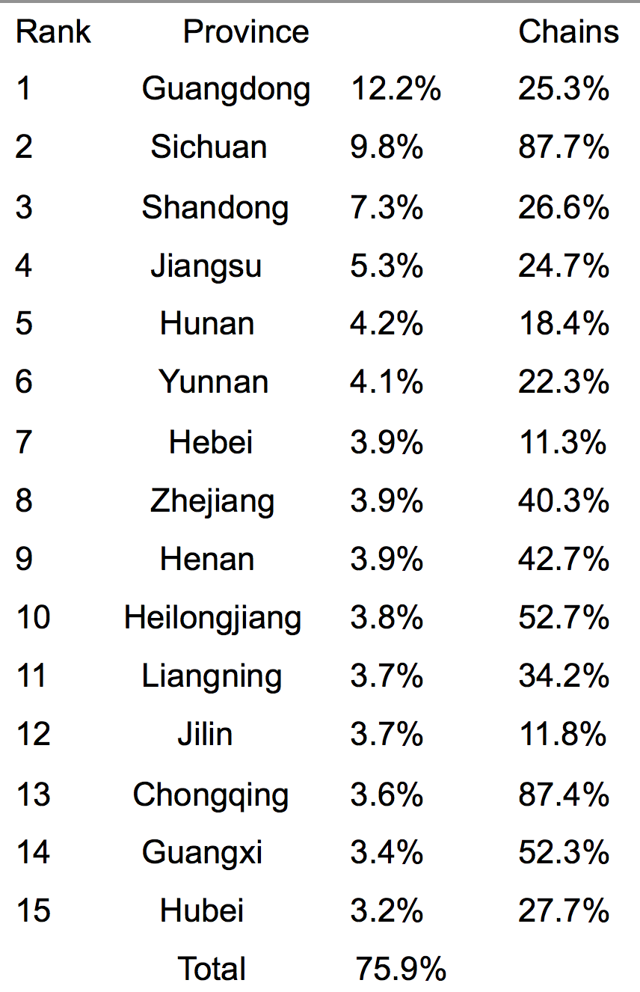
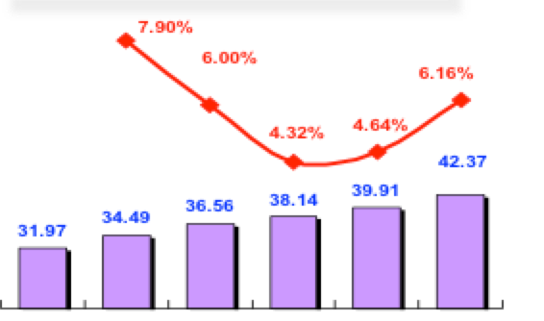
Retailing: Drugstore Geographic
Percentage
China has 0.42 million retail drugstores.
Guangdong, Sichuan, Shandong, Jiangsu, and Hunan possess 38.8% of the total.
Total Number of Drugstores and growth rate
2006
2007
2008
2009
2010
2011
SDFA Southern Healthcare Industry Research Public

Slide 9
Local Healthcare Service
Growth Rate of Local Community Use of Medicine (0.1Billion RMB)
34% of the total market
Growth Rate of Local Use of Medicine（0.1Billion RMB）
Growth Rate of County Level Use of Medicine (0.1Billion RMB)
66% of the total market
SDFA Southern Healthcare Industry Research Public

Slide 10
Treatment Local Distributions
Local Health Institution Charges (RMB)
In 2011, there were 3.8 billion visits to local health institutions. It was 60.7% of the total visits.
Hospitalization was 37.75 million held 25% of the total number.
Local Community Health Centre’s average charge is 81.5 RMB
County Hospital’s average is 49.5 RMB
Local Community Health Centre Visits
County Hospital Visits
Visits (10K)
Visits (0.1B)
SDFA Southern Healthcare Industry Research Public

Slide 11
Three terminals pattern
Drugs Retailer Terminals：
230 billion RMB，21.4%
Local Healthcare Terminals
70.3 billion RMB，6.5%
420K stores
Hospital Terminals：
774.6 billion RMB，72.1%
21979 Hospitals
2012 Drug market cap：1075 billion RMB
Rural
1399，13%
Urban
6347，59.1%
SDFA Southern Healthcare Industry Research Public

Slide 12
Challenges and Opportunities
Opportunities
Recovery of macro economy
Government investment growth
Base propellant expansion and designated production
The improvement of bidding mechanism
Encourage innovation
Promotion of the new version of GMP implementation
Reformation of drug technology transfer examination
Patent protection
Supplements and devices development support
Challenges
Shrink of external demand
Costs pressure
Control of hospital costs and 0 extra fees
Assessment of generic drugs quality’s consistency
Control of drug price

Slide 13
Base propellant expansion and designated production
2013.01.09 Chen Zhu said at the national health work conference，new version of base propellant has approved to pass.
2009
2012
307
500
First-tier health institutes are required to equip with base propellant
Second-tier hospitals’ base propellant usage and sales should reach 40%-50%
Third-tier hospitals’ base propellant usage and sales should reach 25%-30%
Opportunities
SDFA Southern Healthcare Industry Research Public

Slide 14
Changes in bidding mechanism
Main Point
Changes
1. Improve drug quality evaluation system, figure out an efficient way to lower price.
2. Expand purchase area, put high quality and price materials into purchasing list.
3. Centralize essential and non-essential drugs purchasing.
Platform building
Innovation of mechanism
Lower price
Quality and price oriented
Drug bidding
Purchasing contract and usage
Opportunities
SDFA Southern Healthcare Industry Research Public

Slide 15

Innovations
Priority of making price standard for first generic drug
Innovation and generic drugs have priority
Based on level of innovation, set the price
First will have a higher margin than the second
The first 3 generic drugs can make price
Make price standard
Already on sales
90% price of first generic drug
After the first within 5 years,the 2nd and 3rd drug
90% and 80% of the first generic drug
After 5 years
Government set the price
Market selection
Patent protection
More than 4 manufacturers
Government set the price
Opportunities
SDFA Southern Healthcare Industry Research Public

Slide 16
Promotion of the new version of GMP implementation
Eliminated more than 2000 enterprises since last round of GMP
New round of GMP will bring more M&A
New policies:
？
Encourage good enterprises produce more pharmaceutical productions
Encourage enterprises get approved quickly
Limit registration of enterprises which didn’t approve on time
Make approval of producing requirement more strict
There are 597 enterprises get approval of new GMP
Let the leverage of price be exerted adequately
Give bonus for Implementation of centralized drug purchase
New GMP pass rate is about 15%
Support GMP project
Opportunities
SDFA Southern Healthcare Industry Research Public

Slide 17
Control the growth of healthcare fee
Growth rate of visit fee and hospitalization fee shouldn’t be higher than local growth rate of GDP (8%)
Results will be recorded into annually audit
Lower the purchasing costs
Prepay visit fee; hospitalization fee should based on insurance payment type
Growth Rate of hospitalization Fee
Growth Rate of Visit Fee
Challenges
SDFA Southern Healthcare Industry Research Public

Slide 18




Assessment of generic drugs quality’s consistency
High quality Generics
Regular Generics
Low quality Generics
Better than original drug
Same with the original drug
Only about the consistency with the original drug
Ingredients, type, standard, safety, efficiency
5 consistencies
In the future four years, China is going to finish 570 types of drugs evaluation, with 33 thousand approvals and 2400 generics consistencies.
Challenges
SDFA Southern Healthcare Industry Research Public

Slide 19
Drug price control
Set a ceiling for drugs profit margin
Cancel some foreign drugs’ individual price making policy
Supervise costs and finished goods price margin
Support high quality generics
31st
average↓15%
High price drugs↓20%
Challenges
SDFA Southern Healthcare Industry Research Public

Slide 20
Future Trends
New medicines are focusing on prevention
Aging population forces to change the structure of healthcare market
Chronic diseases are becoming major factors
Huge potential of new rural cooperative medical system

